Slide 1

AI Infrastructure
Ioannis Papapanagiotou
AI Workflow

Slide 2
The AI workflow
The AI workflow is a systematic process for developing, deploying, and maintaining AI models.
It typically involves several stages, including data collection, preprocessing, model training, evaluation, deployment, and monitoring.
A well-defined workflow helps ensure the efficiency, effectiveness, and reliability of AI projects.

Slide 3
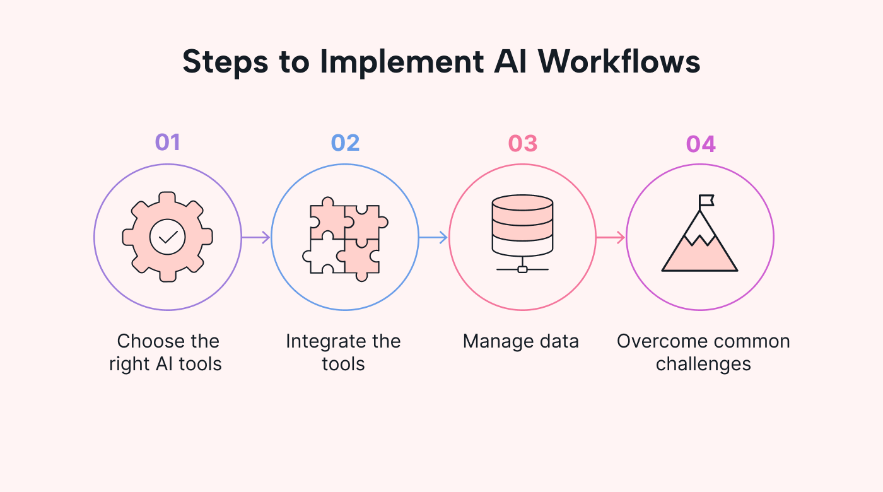
AI Workflow

Slide 4
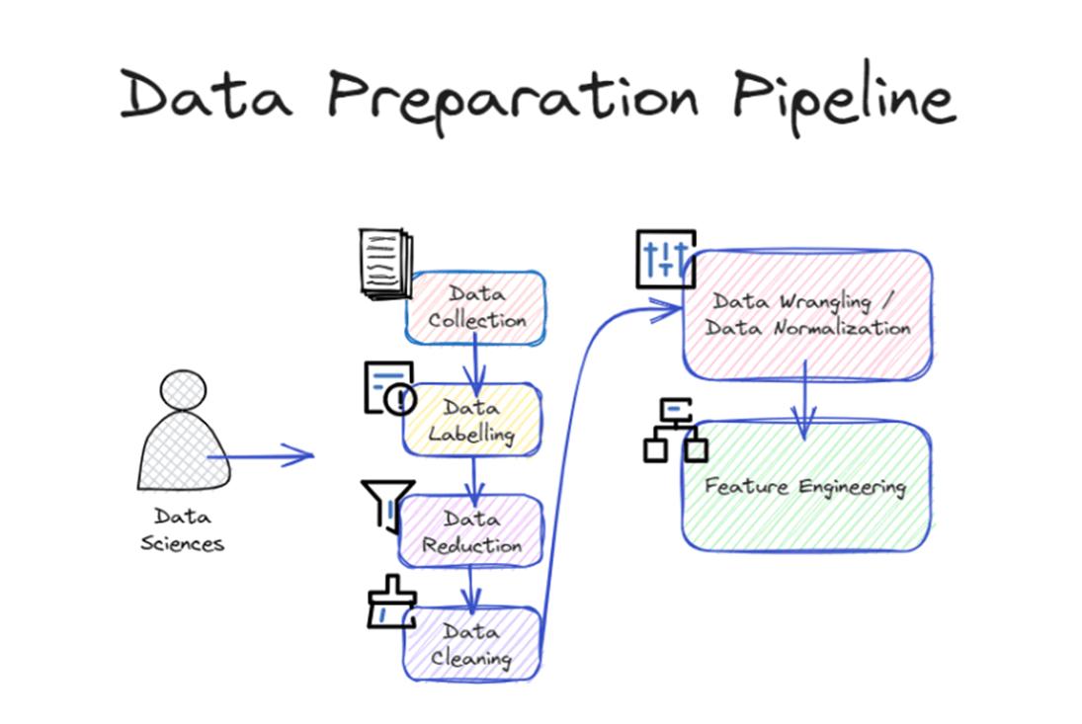
Data Collection and Preparation
The first stage involves gathering relevant data from various sources.
Data preparation includes cleaning, transforming, and organizing data into a suitable format for model training.
Data quality and diversity are crucial for building robust AI models.

Slide 5
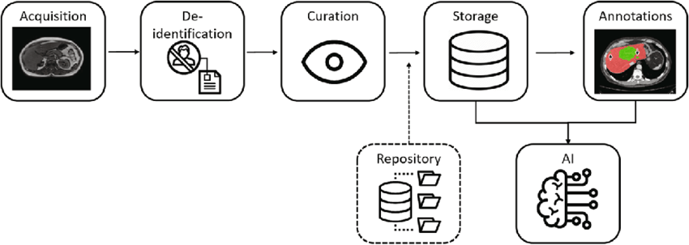
Data Pipeline – Medical Imaging

Slide 6
Model Training and Evaluation
Select and train an appropriate AI model on the prepared data.
Evaluate the model's performance using relevant metrics.
Iterate on the model design and hyperparameters to improve performance.

Slide 7
Model Deployment
Deploy the trained model into a production environment.
Make the model accessible for real-world applications or predictions.
Consider scalability, reliability, and security during deployment.

Slide 8
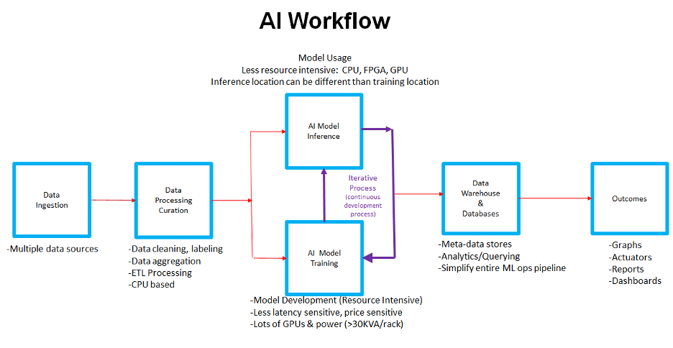
Detailed Workflow

Slide 9
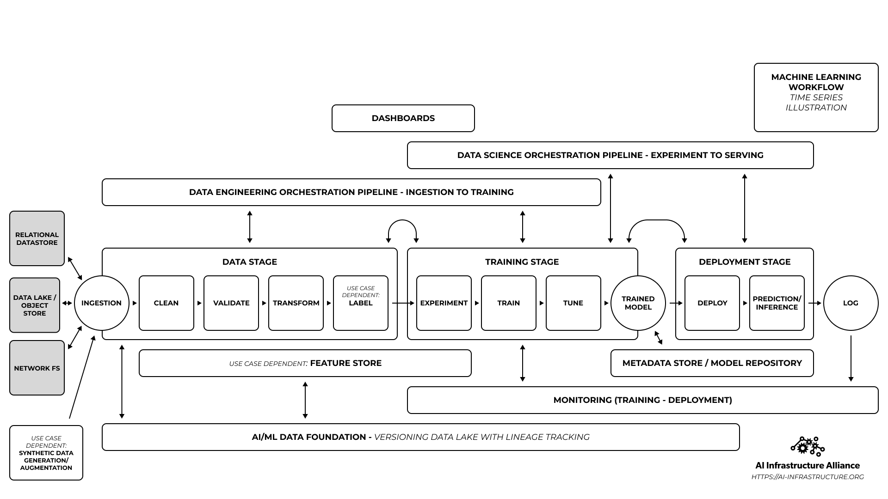
Understanding AI Pipelines

Slide 10
AI Workflow: example
ImageYou is a Radiology clinic that provides services MRI/CT scans to a number of doctors.
They want to provide image recognition services to doctors’ offices for example identifying tumors or fractures in medical imaging.
Betty (ML Engineer) collects historical data of X-rays, MRI and CT scans from hospital and research institutes.

Slide 11
AI Workflow: example 2
For Data Preparation she can use RAPIDS and RAPIDS/NVIDIA.
Once data preparation is complete, Betty will do Model Training with TensorFlow or Pytorch
Once the model training is complete, Betty will optimize it using TensorRT (Deep Learning optimizer) and ready to be deployed and scaled
Betty then moves to inference and can use a platform that can do load balancing etc.

